Slide 1
G2O Military Spending
Nelson Foster
Introduction to Data Mining (DATS 6103)
Individual Project 1

Slide 2
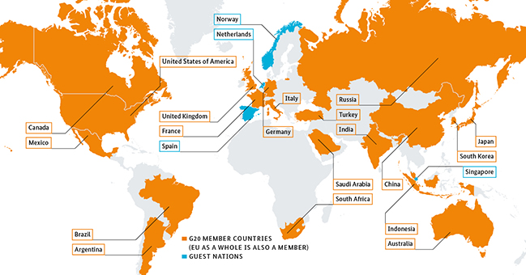

Overview
Data Sources & Tools Used
Exploratory Data Analysis
Findings
Summary/Conclusions

Slide 3
Data Sources & Tools Used
The World Bank’s Open Data website was used to obtain datasets for Gross Domestic Product (GDP) per capita and military expenditures by percentage of GDP
To create a data frame consisting of only the G20, a list of current G20 member nations was obtained from the G20 website hosted by the Federal Government of Germany, who will be hosting the 2017 G20 summit in Hamburg
Utilized Microsoft Excel and Python packages (NumPy, Pandas, and MatPlotLib via Anaconda’s Jupyter Notebook to conduct the analysis
Researched DataCamp training materials, class demonstration examples, and external public resources such as Github and Stack Overflow to navigate through challenges with mining the datasets

Slide 4
Exploratory Data Analysis
Initial Analysis of the excel files was conducted to determine basic descriptive statistics
Average GDP
Average Percentage of GDP
Made copy of original raw dataset to remove extraneous rows but maintain integrity of original for traceability
Two files, one for the GDP Per Capita (GDP.xls) and military expenditures by percentage of GDP (MilSpnd.xls) were read into the Jupyter notebook as data frames (“MS” and “GDP”).
Notes:
Exploratory Data Analysis
Loaded an assortment of libraries in the course of exploring various methodologies, however, Numpy and Pandas were used for the overwhelming majority of the analysis.
To preserve the integrity of the original files, copies of the datasets were made, and extraneous rows were removed from those copies. Initial exploratory data analysis was conducted on the files to determine average overall GDP and military expenditures by percentage of GDP. Two files, one for the GDP Per Capita (GDP.xls) and military expenditures by percentage of GDP (MilSpnd.xls) were read into the Jupyter notebook as data frames (“MS” and “GDP”).

Slide 5
Exploratory Data Analysis (Cont’d)
After looking at the head, tail, and descriptive statistics of the data frames, two new data frames were created to:
Subset to filter for just G20 member nations
Remove years outside of the scope of analysis to focus on 2005-2015
To determine the actual per person military spending (in dollars) amongst the G20 nations, a data frame was created that multiplies the percentage of GDP in military expenditures.
The pd.concat formula was used on the data frame to create a new joined data frame,. This new data frame displays the G20 nations’ per person military expenditures in whole dollars.
To calculate and visualize the rate of growth in order to identify the top ten fastest growing G20 nations in terms of military expenditures, a new variable was needed for the data frame. The new variable, Growth, was created by combining the np.exp , np.diff, and np.log functions in a “growth” formula (np.exp(np.diff(np.log(results))) – 1)
Notes:
Exploratory data analysis was conducted on each dataset by looking at the head, tail, descriptive statistics. This revealed that the datasets contained information on GDP and percentage of GDP dedicated to military spending for every nation from 1960 to present. Two initial data frames were created from the originals:
Military Expenditures by Percentage of GDP Dataframe (“MS”)
To filter for just G20 member nations, the aforementioned list of G20 nations was referenced to create a new data frames by subsetting the original data frame (“MS”), using the loc function. The new data frame was named “G20”
The format of the dataset has the year variable as columnar. Since many of the entries contained null values prior to 1988, and the scope of this project is to look at 5+ years of data for the G20, a drop function was used to remove every year prior to 2005. This function was also used to remove 2016, as this column had null values as well.
Because of the format of the dataset, it didn’t lend itself to a time series analysis. In researching this problem, the groupby function demonstrated in class for the terrorism dataset was used to create a new data frame, named “YearSum.” A time series plot was then created using this new data frame. In researching different types of visualizations I discovered how to create a heatmap, however I didn’t find this to be a very useful visualization for this exercise.
Gross Domestic Product (GDP) DataFrame (“GDP”)
To filter for just G20 member nations, the aforementioned list of G20 nations was referenced to create a new data frames by subsetting the original data frame (“MS”), using the loc function. The new data frame was named “GDPG20”
The format of the dataset has the year variable as columnar. Since many of the entries contained null values prior to 1988, and the scope of this project is to look at 5+ years of data for the G20, a drop function was used to remove every year prior to 2005. This function was also used to remove 2016, as this column had null values as well.
Because of the format of the dataset, it didn’t lend itself to a time series analysis. In researching this problem, I utilized the groupby function demonstrated in class for the terrorism dataset to create a new data frame, named “GDPYearSum.” A time series plot was then created using this new data frame.
Comparing GDP and Military Expenditures by Percentage of GDP
To determine the actual per person military spending to the per person GDP amongst the G20 nations, a data frame was created that multiplies the percentage of GDP in military expenditures (“YearSum”) by the total GDP (“GDPYearSum”), named “frames.” Then, the pd.concat formula was used on the “frames” data frame to create a joined data frame, named “results.” This new data frame displays the G20 nations’ per person military expenditures in whole dollars.
To calculate and visualize the rate of growth in order to identify the top ten fastest growing G20 nations in terms of military expenditures, a new variable was needed for the “results” data frame. The new variable, Growth, was created by combining the np.exp , np.diff, and np.log functions in a “growth” formula (np.exp(np.diff(np.log(results))) – 1)

Slide 6
Findings

Slide 7
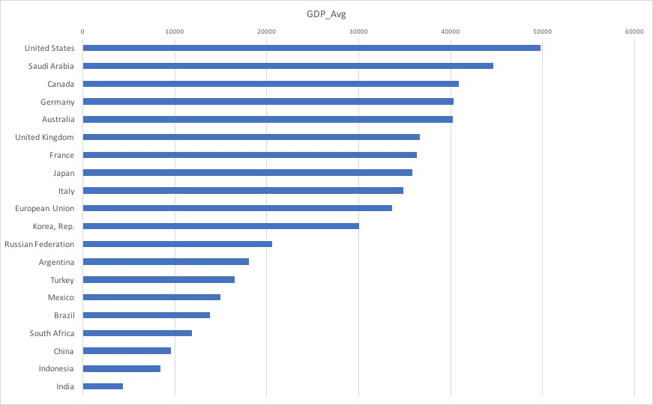
Average GDP among G20 Nations 2005-2015:
Notes:
Among the G20 nations, the top ten in terms of overall GDP are as follows:
United States
Saudi Arabia
Canada
Germany
Australia
United Kingdom
France
Japan
Italy
European Union

Slide 8
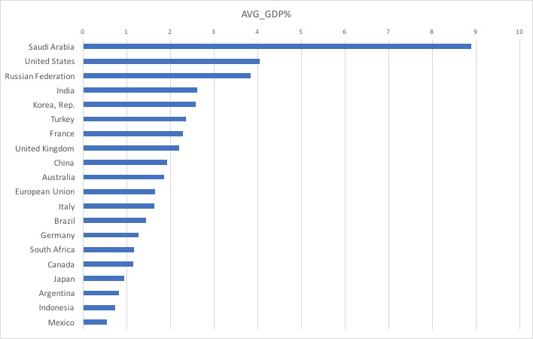
Average Percentage of GDP Military Expenditure among G20 Nations: 2005-2015
Notes:
However, the top ten in terms of military expenditure by GDP percentage are as follows:
Saudi Arabia
United States
Russian Federation
India
Korea, Rep.
Turkey
France
United Kingdom
China
Australia

Slide 9
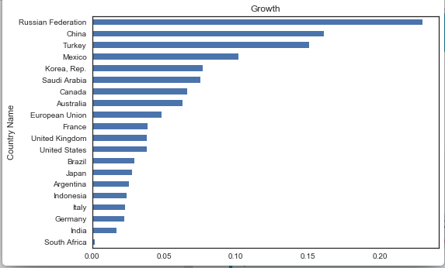
Overall Growth in per Person Military Expenditure Among G20 Nations: 2005-2015
Notes:
According to the growth formula in python, however, from 2005 to 2015, the top ten G20 Member nations are as follows, with a few caveats:
Russian Federation
China
Turkey
Mexico
Korean Republic
Saudi Arabia
Canada
Australia
European Union*
France
United States & United Kingdom*
*The European Union is a confounder because, though it is included in the G20 (G19 + 1), its government is constituted by a confederation of member states, many of which are included in the G20 individually. If the EU is dropped from the list, The United States and United Kingdom would be tied for tenth place.

Slide 10
Summary/Conclusions
From 2005 to 2015:
The United States has the highest GDP amongst the G20 nations
Saudi Arabia commits the greatest proportion of its GDP toward military expenditures
The Russian Federation has the fastest growth in military spending

Slide 11
References
Military Expenditure by GDP data:
http://data.worldbank.org/indicator/MS.MIL.XPND.GD.ZS
GDP per capita data:
http://data.worldbank.org/indicator/NY.GDP.PCAP.PP.CD
Listing of G20 Member Nations
https://www.g20.org/Webs/G20/EN/G20/Participants/participants_node.html
Research on compound annual growth rate, LOGEST, and Growth crosschecks in excel
http://www.igetit.net/newsletters/y06_08/calculategrowth.aspx
http://feliperego.github.io/blog/2016/08/10/CAGR-Function-In-Python
Growth Rate Formula Research
http://stackoverflow.com/questions/26146759/calculating-growth-rate
https://docs.scipy.org/doc/numpy-1.10.1/reference/generated/numpy.log.html
https://docs.scipy.org/doc/numpy/reference/generated/numpy.diff.html
G20 Image Credit
http://www.de.digital/DIGITAL/Redaktion/EN/Dossier/g20-shaping-digitalisation-at-global-level.html
https://www.g20.org/Webs/G20/EN/G20/Participants/participants_node.html

Slide 12

Thank You!
Notes:
Thank you for the opportunity to learn this craft and to demonstrate my progress thus far.

